Slide 1
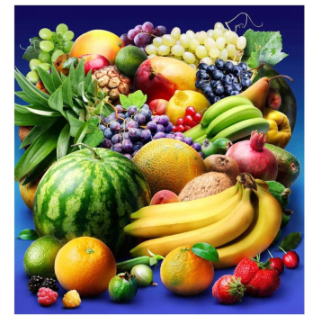
Fruit Colors

Slide 2
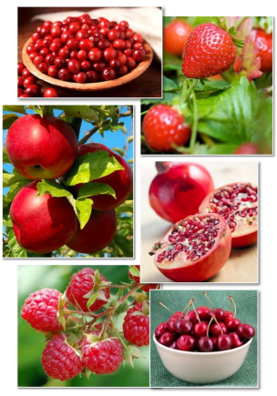
Fruits can be red.

Slide 3
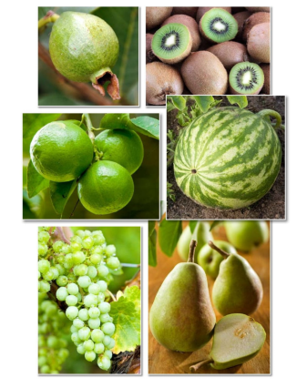
Fruits can be green.

Slide 4
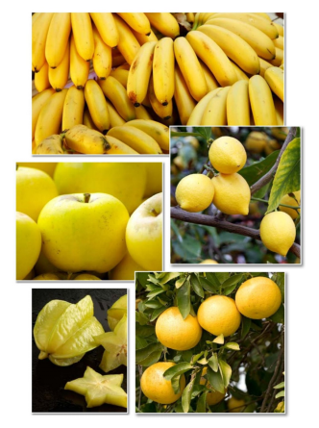
Fruits can be yellow.

Slide 5
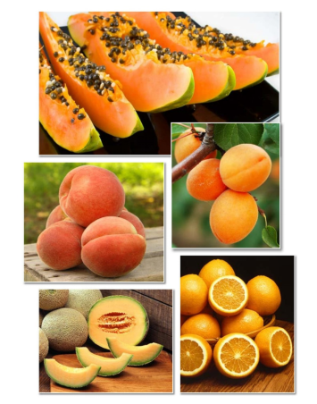
Fruits can be orange.

Slide 6
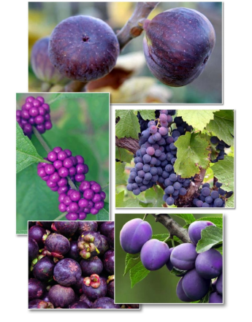
Fruits can be purple.

Slide 7
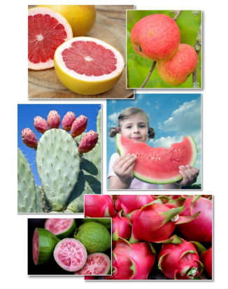
Fruits can be pink.

Slide 8

Can fruits be blue?

Slide 9
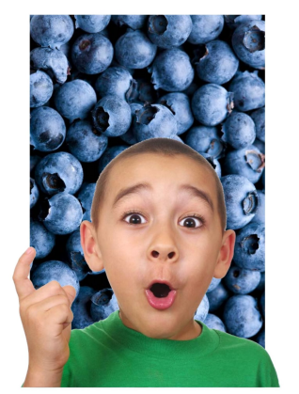
Yes , they can!

Slide 10
Red
Green
Yellow
Orange
Purple
Pink
Blue
Click on the colored buttons to start getting to know them!

Slide 11
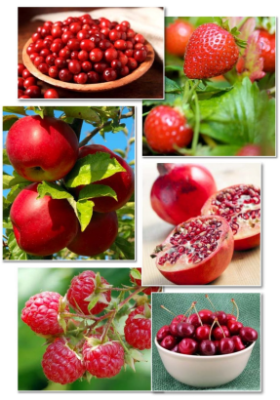
Fruits can be red.
Return

Slide 12
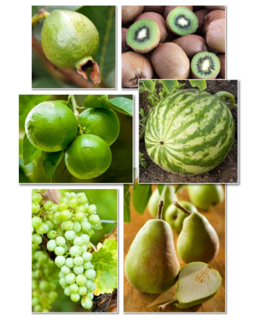
Fruits can be green.
Return

Slide 13
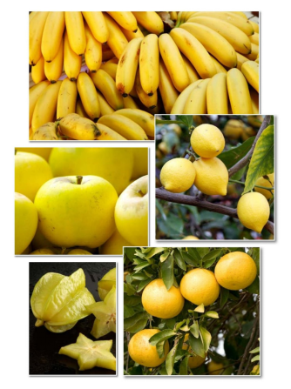
Fruits can be yellow.
Return

Slide 14
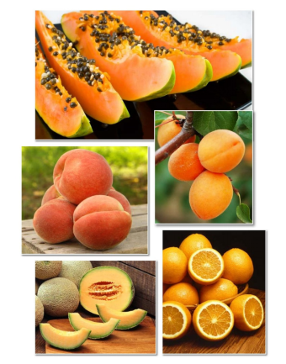
Fruits can be orange.
Return

Slide 15
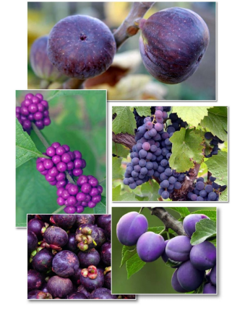
Fruits can be purple.
Return

Slide 16
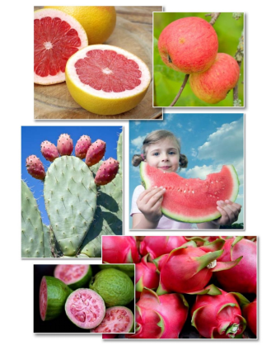
Fruits can be pink.
Return

Slide 17
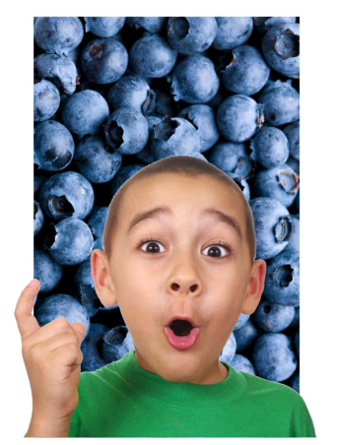
Yes , they can!
Return

